Slide 1

Angular 6
Lesson 02

Slide 2
Objectives

Slide 3
Introduction to Angular Framework
Introduction to Angular Framework, History & Overview
Environment Setup
Angular CLI, Installing Angular CLI
NPM commands & package.json
Bootstrapping Angular App, Components, AppModule
Project Setup, Editor Environments
First Angular App & Directory Structure
Angular Fundamentals, Building Blocks
MetaData

Slide 4
Introduction to Angular Framework

Slide 5
Angular Framework…
Angular is an open source JavaScript library that is sponsored and maintained by Google.
Angular applications are built around a design pattern called Model-View-Controller (MVC)

Slide 6
Angular Framework…
Extendable: It is easy to figure out how even a complex Angular app works once you understand the basics—and that means you can easily enhance applications to create new and useful features for your users.
Maintainable: Angular apps are easy to debug and fix, which means that long-term maintenance is simplified.
Testable: Angular has good support for unit and end-to-end testing, meaning that you can find and fix defects before your users do.
Standardized: Angular builds on the innate capabilities of the web browser without getting in your way, allowing you to create standards compliant web apps that take advantage of the latest features (such as HTML5 APIs) and popular tools and frameworks.

Slide 7


Angular-History
Angular was created in the year 2009 as AngularJS
It is large and fastest-growing
community
It is open source and supported by Google

Slide 8
The first stable version
Patch Releases
Bug Fixes
Small Features
Additional concepts from angular
Concept of Component based architecture
Performance
The changing web
Mobile
Ease to use
Angular 1.3
Angular 1.4
Angular 1.5
Angular 1.6
Angular 2.0
Angular 4
Performance Boost
30% faster digest times
New Router
Internationalization
Ng-animate, ng-messages
Sandbox support removed
Uses new router
Uses ES6 Modules
Smaller and Faster
Animation package
Angular Universal
Typescript 2.1 and 2.2 compatibility
New ParamMap interface

Slide 9
Simpler Progressive Web Applications
Material Design
Build optimizer
Angular Universal API and DOM
Improved Compiler and Typescript
CLI v1.5
Router Hooks
Number, date and currency pipes update
Angular 5
Angular 6
Improved CLI
RxJS Revamp
Library Generation Support
Ivy – the cutting-edge rendering pipeline
Angular Elements

Slide 10
Angular Features
Cross platform
Speed and performance
Productivity
Full development story

Slide 11
Building Blocks
Services
Directives
Components
Module
Templates
Metadata
Pipes
Components
Modules
Templates
Metadata
Pipes
Services
Directives
Building Blocks

Slide 12
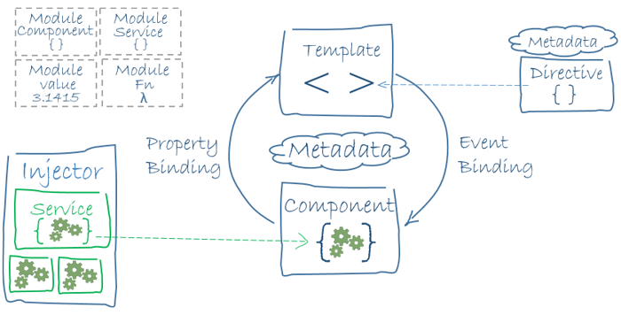

Slide 13
Modules
Angular apps are modular and Angular has its own modularity system called NgModule.
Every Angular app has at least one NgModule class, the root module, conventionally named AppModule.

Slide 14
Angular libraries
Angular ships as a collection of JavaScript modules. You can think of them as library modules.
Each Angular library name begins with the @angular prefix. You install them with the npm package manager and import parts of them with JavaScript import statements.
Component @angular/core
BrowserModule @angular/platform-browser
FormsModule @angular/forms

Slide 15
Component
A component controls a patch of screen called a view and used to manage templates.
You define a component's application logic—what it does to support the view—inside a class.
The class interacts with the view through an API of properties and methods.

Slide 16
Template
A template is a form of HTML that tells Angular how to render the component
Metadata
Metadata tells Angular how to process a class. We can attach metadata to a class by using a decorator. @Component, @Injectable, @Input, and @Output are a few of the more popular decorators

Slide 17

Environment Setup
Node.Js and npm
To get started with Angular, you’ll need to have Node.js installed.
There are a couple of different ways you can install Node.js, so please refer to the Node.js website for detailed information https://nodejs.org/download/
Angular CLI
CLI – Command Line Interface – This is simply a tool set, which is used for creating, managing and building angular applications quickly.
It quickly creates new angular projects, and then you can use some commands to build that project for production and so on.
> npm install -g @angular/cli
VS Code
Visual Studio Code is a lightweight but powerful source code editor which runs on your desktop and is available for Windows, macOS and Linux.
Download VS Code - Quickly find the appropriate install for your platform (Windows, macOS and Linux).

Slide 18
Create a new Angular application

Slide 19
AngularJS is based on the model view controller, whereas Angular 2/4/5/6 is based on the components structure.
To install Angular framework, the Angular team came up with Angular CLI which eases the installation. You need to run through a few commands to install Angular.
Go to this site https://cli.angular.io to install Angular CLI.

Slide 20
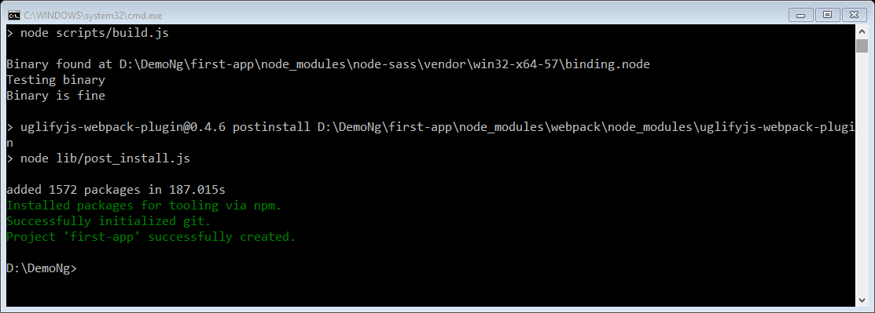
Create a new project named first-app with this CLI command.
> ng new first-app
We will use Visual Studio Code IDE for working with Angular; you can use any IDE, i.e., Atom, WebStorm, etc.
To download Visual Studio Code, go to https://code.visualstudio.com/ and click Download for Windows.

Slide 21
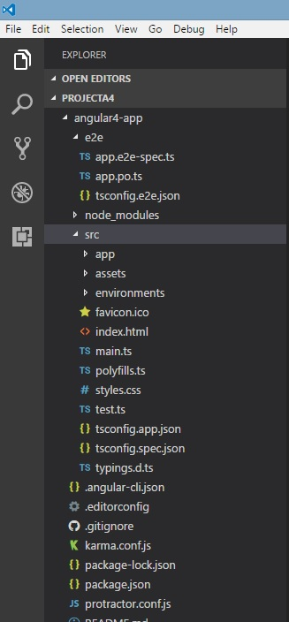
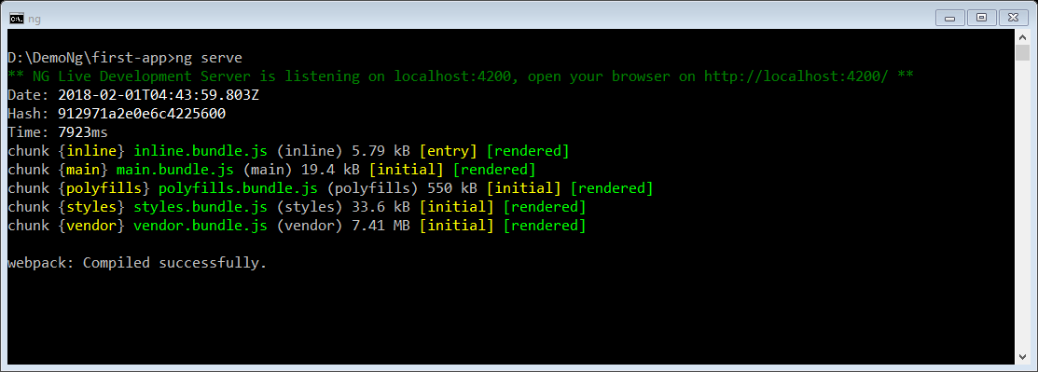
Now that we have the file structure for our project, let us compile our project with the following command −
> ng serve
The ng serve command builds the application and starts the web server.

Slide 22
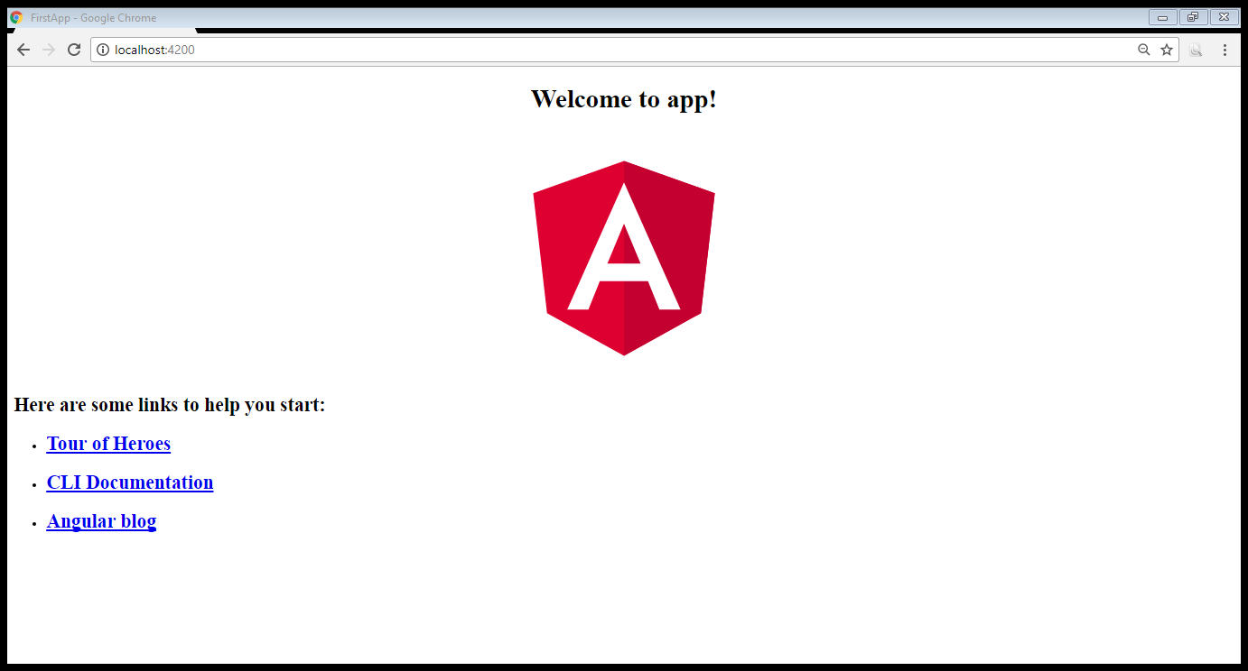
The web server starts on port 4200. Type the url http://localhost:4200/ in the browser and see the output. Once the project is compiled, you will receive the following output −
Once you run http://localhost:4200/ in the browser, you will be directed to the following screen −

Slide 24
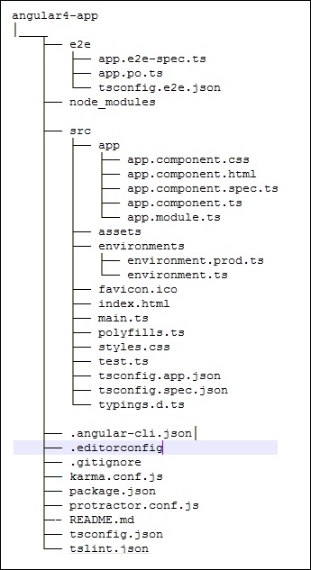
Project folder structure
The Angular app folder has the following folder structure −
e2e − end to end test folder. Mainly e2e is used for integration testing and helps ensure the application works fine.
node_modules − The npm package installed is node_modules. You can open the folder and see the packages available.
src − This folder is where we will work on the project using Angular.
app - The Angular app folder has the following file structure –
.angular-cli.json − It basically holds the project name, version of cli, etc.
.editorconfig − This is the config file for the editor.
.gitignore − A .gitignore file should be committed into the repository, in order to share the ignore rules with any other users that clone the repository.
karma.conf.js − This is used for unit testing via the protractor. All the information required for the project is provided in karma.conf.js file.
package.json − The package.json file tells which libraries will be installed into node_modules when you run npm install.
protractor.conf.js − This is the testing configuration required for the application.
tsconfig.json − This basically contains the compiler options required during compilation.
tslint.json − This is the config file with rules to be considered while compiling.

Slide 25
App
The App directory contains the files described below. These files are installed by angular-cli by default.
app.module.ts − If you open the file, you will see that the code has reference to different libraries, which are imported. Angular-cli has used these default libraries for the import – angular/core, platform-browser. The names itself explain the usage of the libraries.
They are imported and saved into variables such as declarations, imports, providers, and bootstrap.
import { BrowserModule } from '@angular/platform-browser';
import { NgModule } from '@angular/core';
import { AppComponent } from './app.component';
@NgModule({
declarations: [
AppComponent
],
imports: [
BrowserModule
],
providers: [],
bootstrap: [AppComponent]
})
export class AppModule { }

Slide 26
AppModule
declarations − In declarations, the reference to the components is stored. The Appcomponent is the default component that is created whenever a new project is initiated. We will learn about creating new components in a different section.
imports − This will have the modules imported as shown above. At present, BrowserModule is part of the imports which is imported from @angular/platform-browser.
providers − This will have reference to the services created. The service will be discussed in a subsequent chapter.
bootstrap − This has reference to the default component created, i.e., AppComponent.

Slide 27
app.component.css − You can write your css structure over here. Right now, we have added the background color to the div as shown below.
app.component.html − The html code will be available in this file.
app.component.spec.ts − These are automatically generated files which contain unit tests for source component.
app.component.ts − The class for the component is defined over here. You can do the processing of the html structure in the .ts file. The processing will include activities such as connecting to the database, interacting with other components, routing, services, etc.

Slide 28
How Angular Works

Slide 29
How Angular Works
The first big idea is that an Angular application is made up of Components.
One way to think of Components is a way to teach the browser new tags.
If you have an Angular 1 background, Components are analogous to directives in AngularJS 1.x

Slide 30
How Angular Works
Every app has a main entry point. This application was built using Angular CLI (which is built on a tool called Webpack). We run this app by calling the command:
> ng serve
ng will look at the file .angular-cli.json to find the entry point to our app
.angular-cli.json specifies a "main" file, which in this case is main.ts
main.ts is the entry-point for our app and it bootstraps our application
The bootstrap process boots an Angular module (“AppModule”)
We use the AppModule to bootstrap the app. AppModule is specified in src/app/app.module.ts
AppModule specifies which component to use as the top-level component. In this case it is AppComponent
AppComponent has <app-root> tags in the template and this renders output

Slide 31
